Slide 1
Pre-proposal Meeting
Consulting Services for
10-Year Facilities Master Plan
April 8, 2021
Kathy Meagher, PE
Director of Campus Facilities & Security
Notes:
Check ZOOM
Info will be posted on the Garrett College website

Slide 2
Agenda
Garrett College Background
Scope of Work
Proposals
Consultant Selection Process
Schedule
Questions
Highlights from Current FMP
Campus Tour

Slide 3
Garrett College Background
Established 1970, two-year community college
Rural county of 30,000 residents
Economically disadvantaged
Enrollment growth 2006 to 2011, decline since
  Unduplicated headcount of 796 in FY18
Revenue from tuition, state and county
Transition in Institutional Leadership

Slide 4
Garrett College Background
64 Acres
320,000 GSF of Building Inventory
18 buildings on main campus
3 Outreach Centers

Slide 5
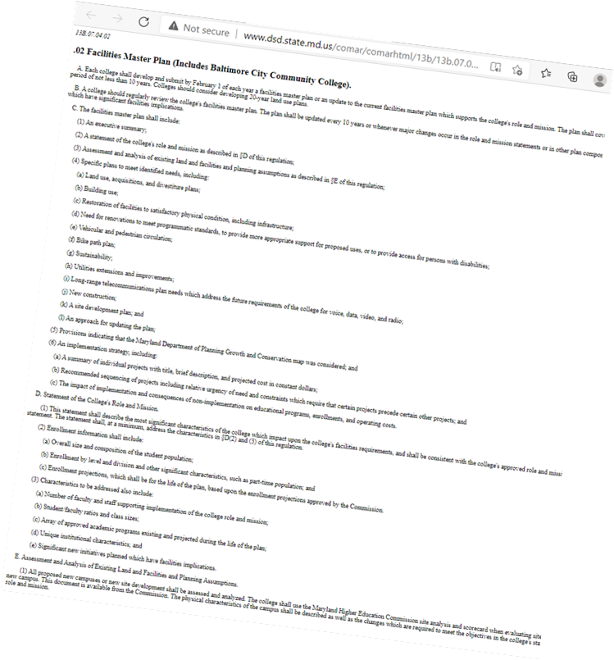
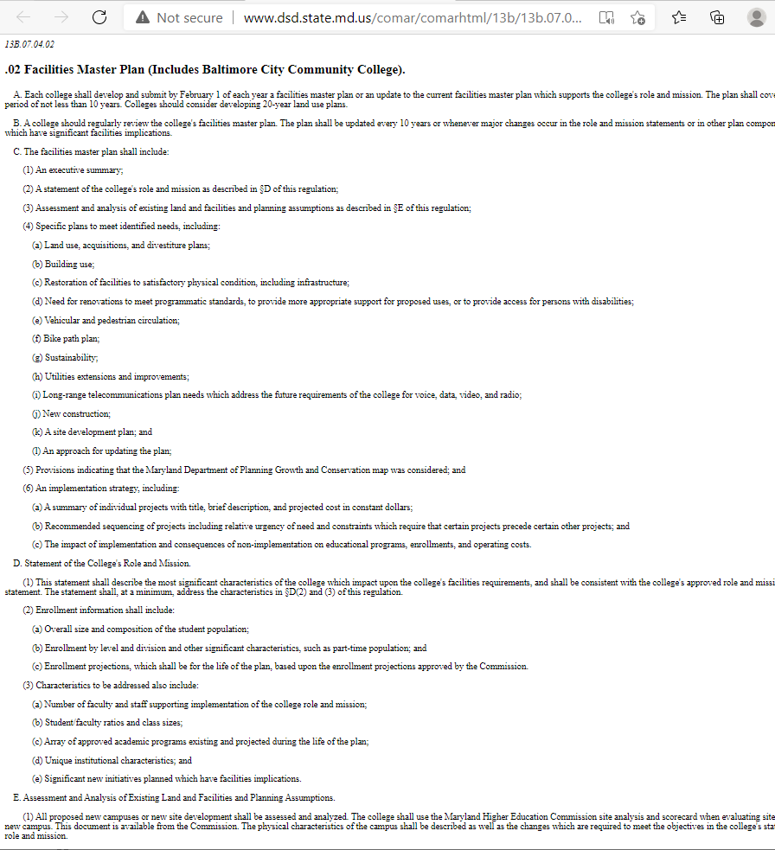
Scope of Work
RFP
COMAR
  Title 13B, Chapter 4, Regulation 02: Facilities Master Plan
Maryland Higher Education Commission
  Facilities Planners Manual: Facilities Master Plans
Garrett College Areas to Address

Slide 6


Scope of Work
Goals from COMAR
  “…capital construction results from the need to accommodate people, modernize or replace facilities, or provide space for services or programs.”
  The Facilities Master Plan “should
    evaluate current conditions and projected needs,
    develop proposals for addressing any deficiencies noted, and
    present a recommendation which will enable the community college to meet its strategic goals over the plan period.”

Slide 7
Scope of Work
COMAR & MHEC Details
  Enrollment, student, program, and employee data
  Institutional goals and evaluations
  Facility assessments
  Recommendations for capital programming
  Etc.

Slide 8
Scope of Work
10-Year Facilities Master Plan Defined Layout
  Executive Summary
  Overview of the Institution
  Institutional Background Data
  Institutional Evaluation
  Facilities Master Plan Proposals
  Recommendations
  Garrett College Areas to Address

Slide 9
Scope of Work
Garrett College Areas to Address
  Review and recommend technology & its role in instruction and administration
  Address main entry for the college
  Architectural themes / guidelines
  Athletic facilities and fields
  Safety & security
  Gender neutral restrooms
  Wayfinding and signage
  Consolidation of Student Services
  Use of Facilities Renewal Grant Funding
  ______

Slide 10
Scope of Work
Methodology
  FMP Leadership Team
  College documents and data
  Employee interviews, workgroups

Slide 11
Proposals
Per the RFP Proposals to Include:
  Title Page
  Conflict of Interest, Ethics, and Acknowledgement of Addendum
  Bid / Proposal Affidavit
  Price Proposal and Fee Schedule
  Certifications - Licensure and Certification
  Insurance
  Project Approach
  Firm Qualifications
  Key Personnel Qualifications
  References
  ______

Slide 12
Consultant Selection Process
Written Proposals
  Project Approach
  Firm Experience
  Key Personnel Experience
  References
  Cost
Interviews
Award to most responsive and reliable firm for successful completion of our FMP

Slide 13
Schedule
Pre-Proposal Meeting & Site Tour April 8
Questions Due April 13
Answers / Addendum Issued April 15
Proposals Due April 21
Interview Invitations April 30
Interviews May 12-14
Consultant Selection May 21
Board of Trustees Contract Approval June 15
Commence Work July 1
Submitted to State February 1, 2022

Slide 14
Questions
https://www.garrettcollege.edu/purchasing
Chris.Jones@garrettcollege.edu

Slide 15
Highlights from Current FMP
Building 400 Student Center FY24
Building 600 Shaw Learning Center
Building 700 Administration and Student Services
Turf Fields
Deferred Maintenance Plan

Slide 16
Campus Tour

Slide 17
Thank You!

